Slide 1
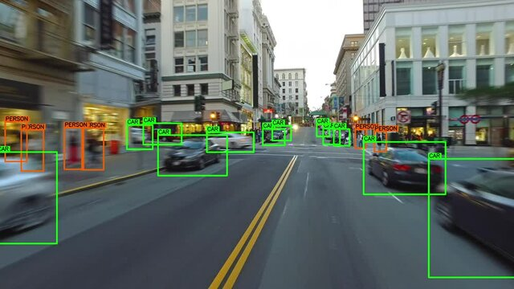
Moving Object Detection
Based On Background Subtraction Using Energy Function
Supervised By – Manas Ghosh (Assistant Professor)

Slide 2

RCCIIT Information Of Technolgy
Canal south road, beliaghata, kol-700015
Group Members
Adrija Mukherjee (11771022003)
Suman Naskar (11771022050)
Samanwaya Bhattacharya(11771022021)
Priyanka Dutta (11771022022)

Slide 3

INTRODUCTION
In this presentation, we will explore the advancements in moving object detection through energy-based background subtraction. We will delve into the techniques and technologies that enable enhanced vision and improved object recognition.
Traditional Algorithms – VJ Detector Algorithm , HOG Algorithm, DPM Algorithm.
Deep Learning Algorithms - RCNN, SPPNet, SSD Algorithms.

Slide 4

AIM (Problem Definition)
Our aim was to build a system that should excel in accurately detecting and tracking moving objects against a non-changing backdrop, with a focus on the key challenges-Background Subtraction, Noise reduction and object tracking.

Slide 5
WORKFLOW DIAGRAM
Video Inputs
Frame Extraction
Key Point Detection
Colored Frames To Grayscale frames
Grayscale Frame To Binary Image
Calculate Energy Function Between Current Frame And Previous Frame
Binary Mask Generated
Bounding Box Using Contour
Dilation Operation

Slide 6
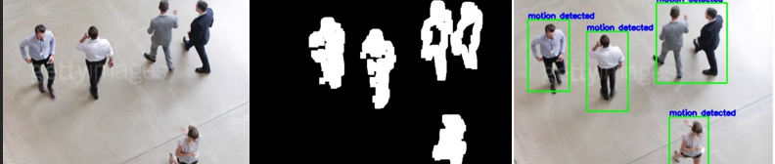
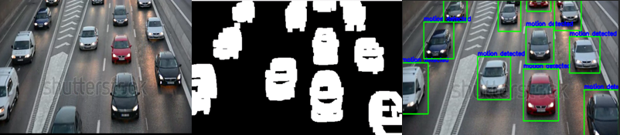
Experimental Results
Normal Image
Binary Image
Detected Object
Normal Image
Binary Image
Detected Object

Slide 7

CONCLUSION
Moving object detection is a crucial task in video surveillance systems. The process involves detecting and tracking moving objects in video sequences captured by static or CCTV cameras. The algorithm typically involves steps such as sampling the video into frames, converting RGB frames to grayscale, applying entropy values, background subtraction, and morphology-based object detection. The detection of moving objects is essential for video surveillance and has applications in various domains such as traffic monitoring and indoor security. While the algorithm may not be highly accurate, it provides satisfactory results within a short time frame.
This method has two shortcomings, one it works only with a static background. If the background is also dynamic it could not detect, as it cannot differentiate between foreground and background. Mostly it will consider the whole frame as one moving object. Another one is it cannot work properly on those videos, which have highly congested moving objects, meaning too many moving objects at very short places. It will consider objects as a single object with a single boundary box so the accuracy will drastically decrease.

Slide 8

THANK YOU

